Slide 1
Law and Finance
JPE Dec 1998
La Porta, Lopez de Silanes, Shleifer and Vishny

Slide 2
Innovative Way of Measuring Laws Relative to Financial Markets
Send Questionnaires and Conduct Interviews with Bar associations in various countries
Shareholder rights for equity (Stock) markets
Credit Markets and Creditor Rights

Slide 3
Relate these Indexes of development to Legal traditions
Also consider enforcement
Possible offsets that can be used when legal protections weak

Slide 4
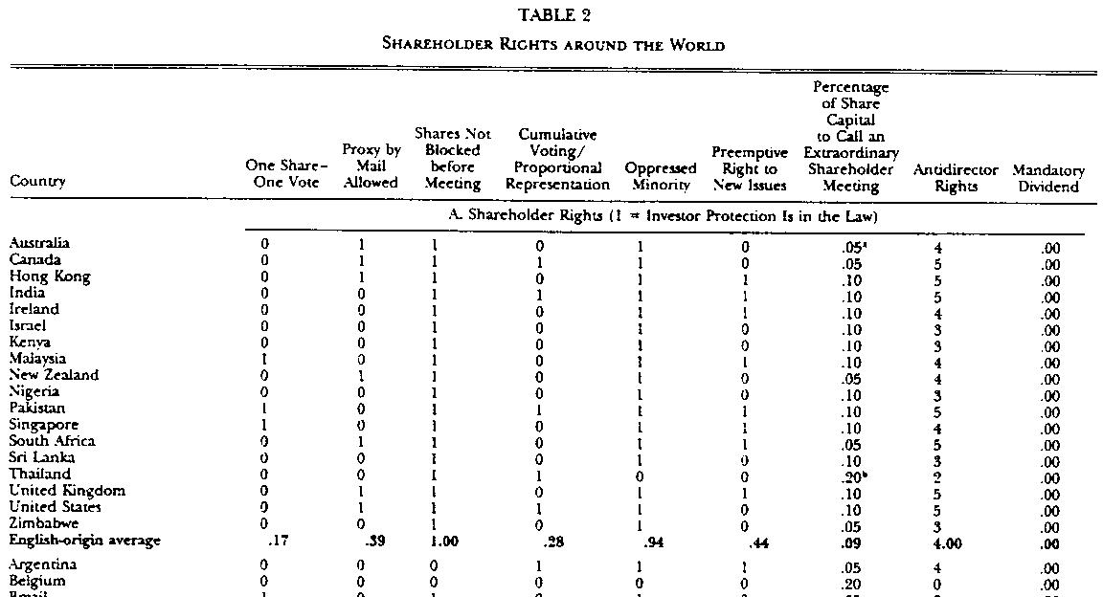

Slide 5
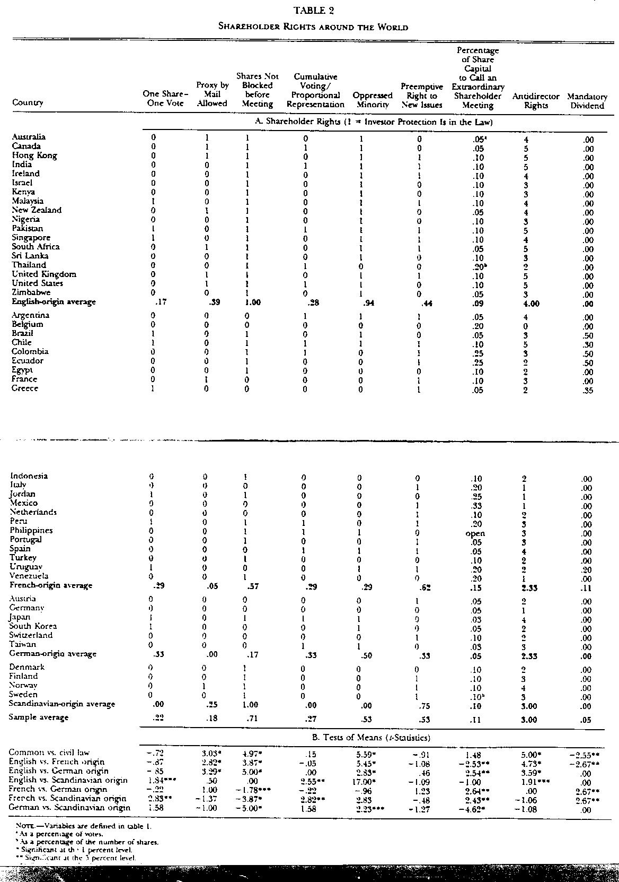

Slide 6
Overall Comparison Shareholder Rights
Country | 1 sh=1Vote | Proxy Mail Ballot | No Block | Cum. Voting | Minority Rights | Pre-emptive Right | % to Call Meet | AntiDire. Rights | Mand. Dividend
ENL | .17 | .39* | 1.0* | .28 | .94* | .44 | .09 | 4.0* | .0
FL | .29 | .05 | .57 | .29 | .29 | .62 | .15 | 2.3 | .11*
GL | .33 | .0 | .17 | .33 | .5 | .33 | .05 | 2.3 | .0
SCL | .0 | .25 | 1.0 | .0 | .0 | .75 | .1 | 3.0 | .0

Slide 7
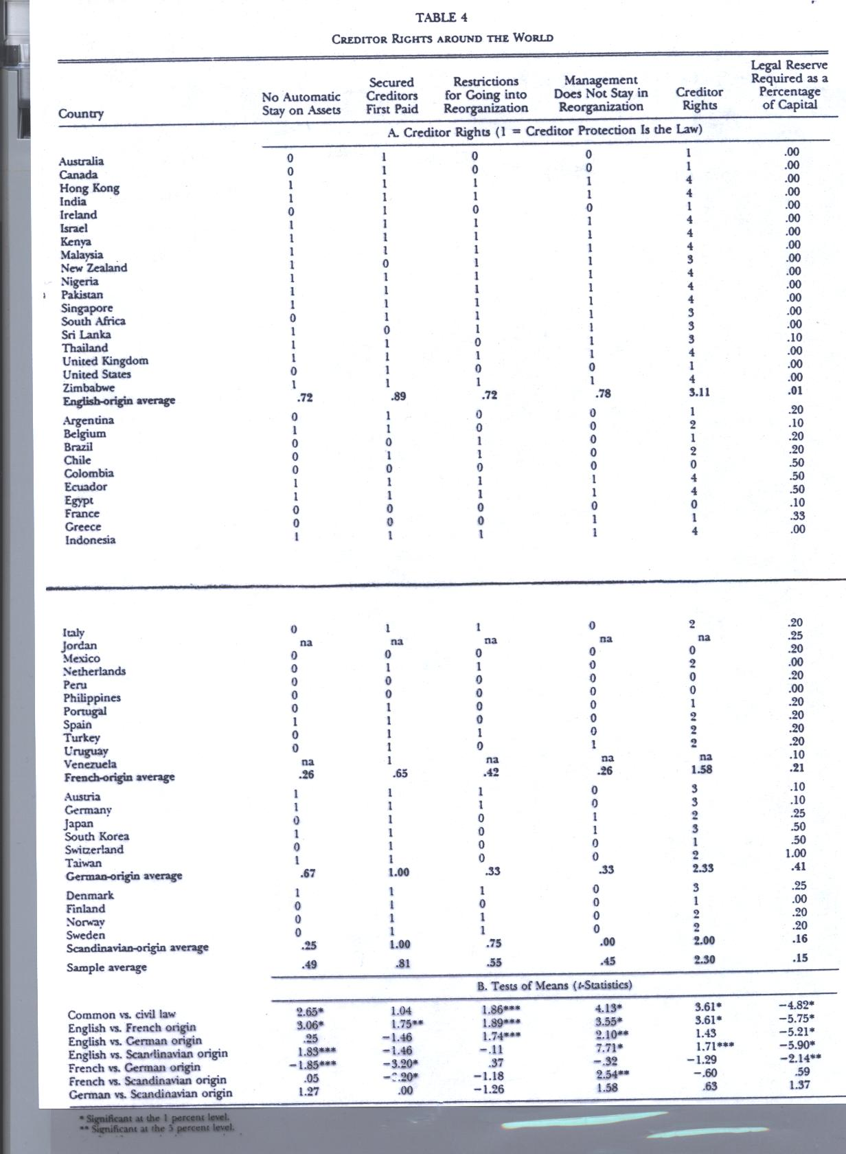

Slide 8
Creditor Rights
Country | No Stay on Assets Reorg | Secured CreditorsFirst Paid | Restrict-ions on Going into Reorg | Management Can’t Stay | Various Creditor Rights Aggregated | Min. % Share Capital to avoid Dissolution
ENGL | .72* | .89* | .72* | .78* | 3.11* | .01
FRL | .26 | .65 | .42 | .26 | 1.58 | .21
GL | .67* | 1.0* | .33 | .33 | 2.33 | .41*
SCL | .25 | 1.0* | .75* | .00 | 2.0 | .16

Slide 9
For Most Creditor Rights Indicators
Common Law Scores > Civil Law
English Law > French Civil Law
Other civil law> French Civil law
Exception is with respect to Legal Reserve Required as % of Capital to Avoid Dissolution. They argue that it is a last resort and probably not needed in CL countries

Slide 10
Can strong legal enforcement system substitute for weak rules?
Use 5 measures of law and order
Also measure of quality of accounting standards

Slide 11
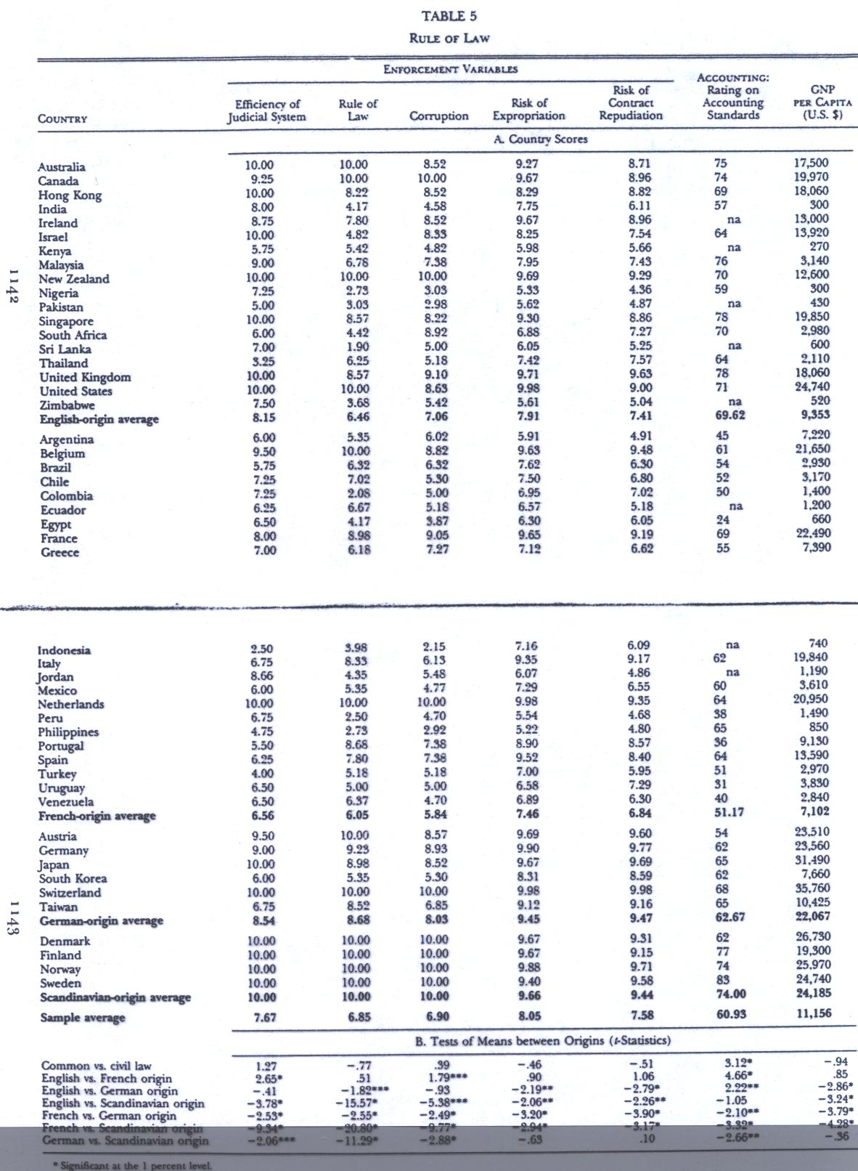

Slide 12
Summary of Table 5
In law enforcement Scandinavian countries are on top with German law countries close second
Common law countries ahead of French Civil law countries
On accounting standards, Scandinavia followed by English common law
Hence, clearly French civil law countries are more poorly served by both investor rights and enforcement and accounting

Slide 13
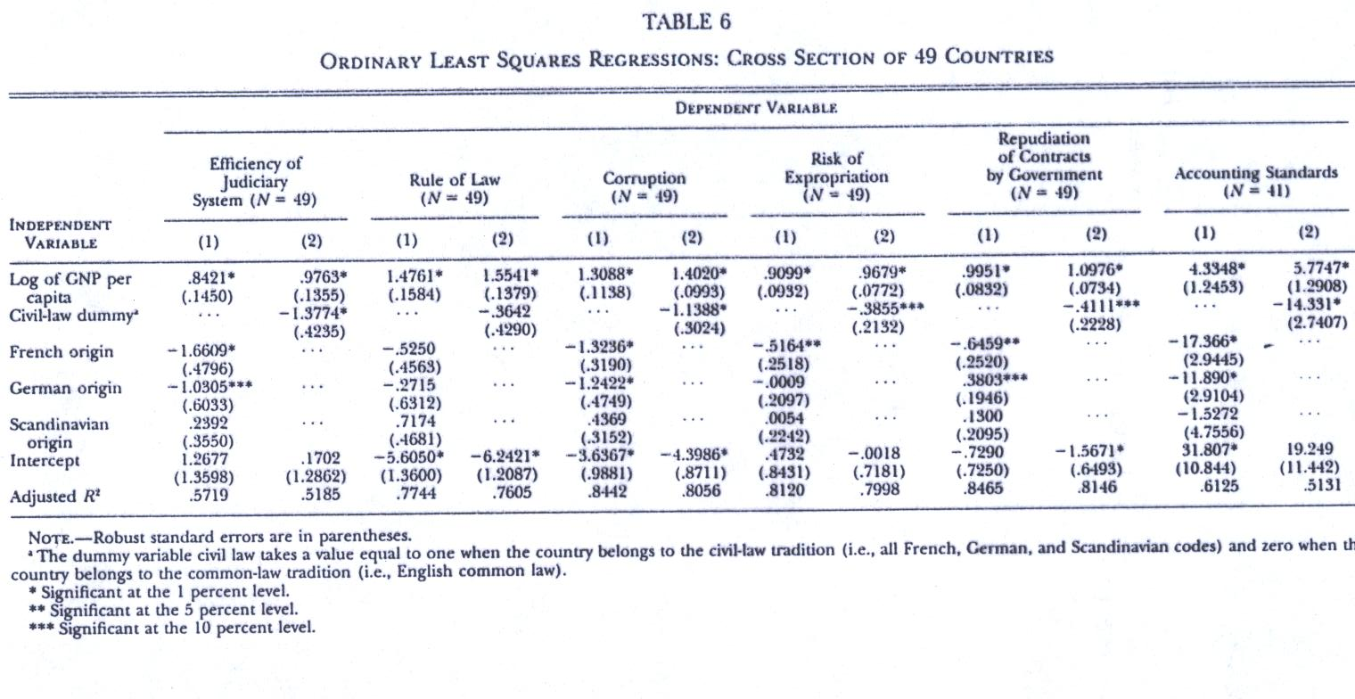

Slide 14
Regression results
Show that these conclusions hold up even after controlling for income per capita
Income per capita has highly significant correlation with these enforcement measures

Slide 15
Ownership Concentration Hypothesis
In countries with poor investor protection, ownership expected to be more concentrated
  Need more ownership to have incentive to avoid expropriation by managers
  When poorly protected, small investors unwilling to buy shares unless offered at extremely low prices
  More incentive for large shareholders to monitor managers

Slide 16
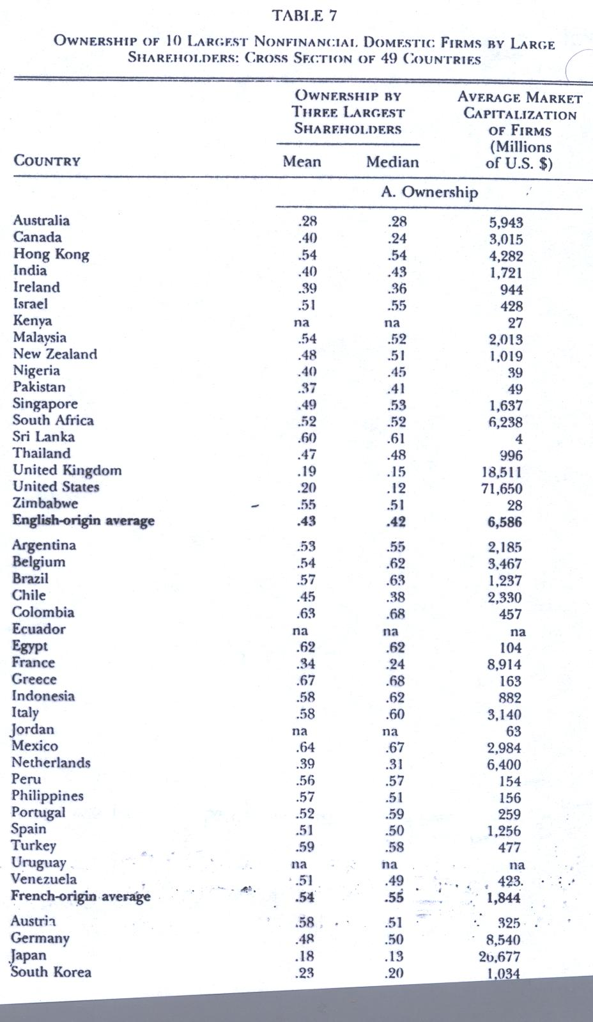

Slide 17
Ownership Concentration Results
It is especially low for the US, UK = .20
Region | Ownership by 3 Largest Shareholders
English | .43
French | .54
German | .34
Scandinavian | .37

Slide 18
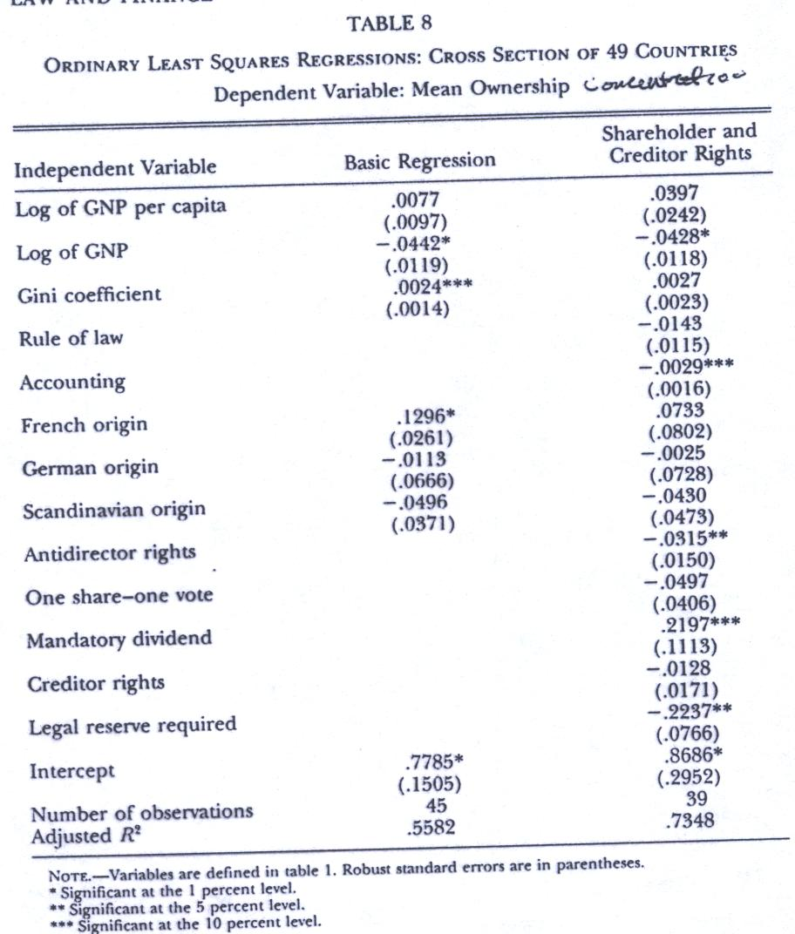

Slide 19
Conclusion
Legal Tradition Matters for Development of capital Markets, though somewhat differently between credit and equity markets
Ways of off-setting disadvantages of Civil Law
  Concentration of owners
  Close relations between banks and firms

Slide 20
Comments
International Cross section Limitations
  Unobserved variables may be correlated with included variables and resulting bias
  Impacts over time may be different than across countries
Does not account for transplant issues and problems
Does not deal with increasing homogenization of international law
Reversed Causality: Do Markets create friendly laws?
Ignored within country variation which is considerable in US, Canada

Slide 21
Update: La Porta, Lopez-de-Silanes and Shleifer JEL 2008
Economic Consequences of Legal Origins
Discusses transplantation but argues that the adaptation to local conditions is incomplete so legal institutions can still be typed and classified. Have changed the classification of socialist to their pre-soviet classifications

Slide 22
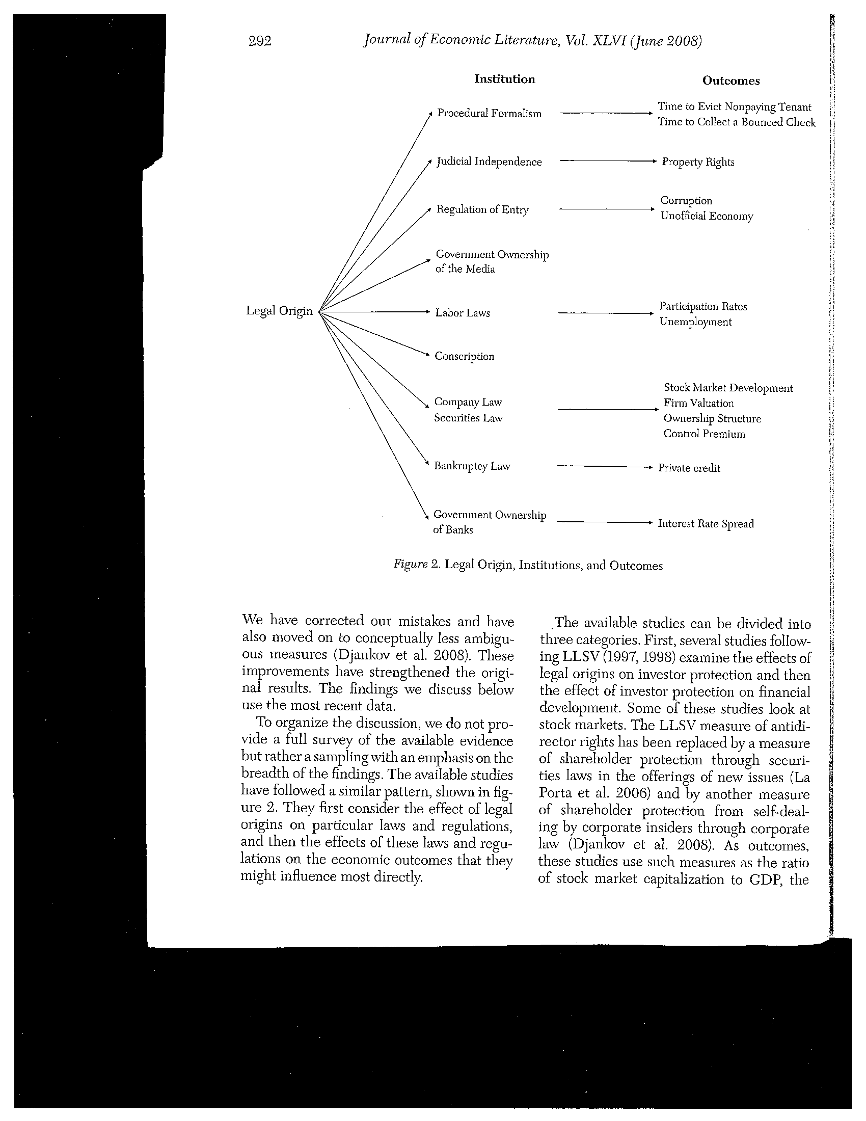

Slide 23
Have replaced Shareholder rights
With Shareholder protection from self-dealing by corporate insiders through corporate law
Shareholder protection through securities laws in the offering of new issues

Slide 24
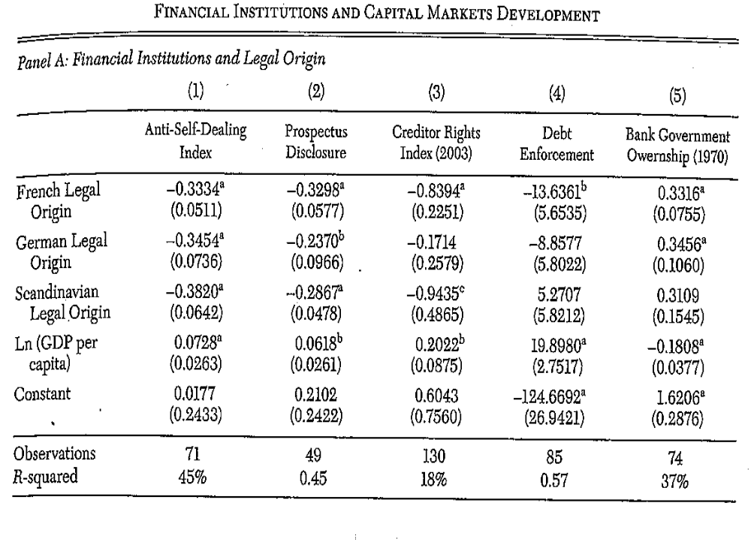

Slide 25
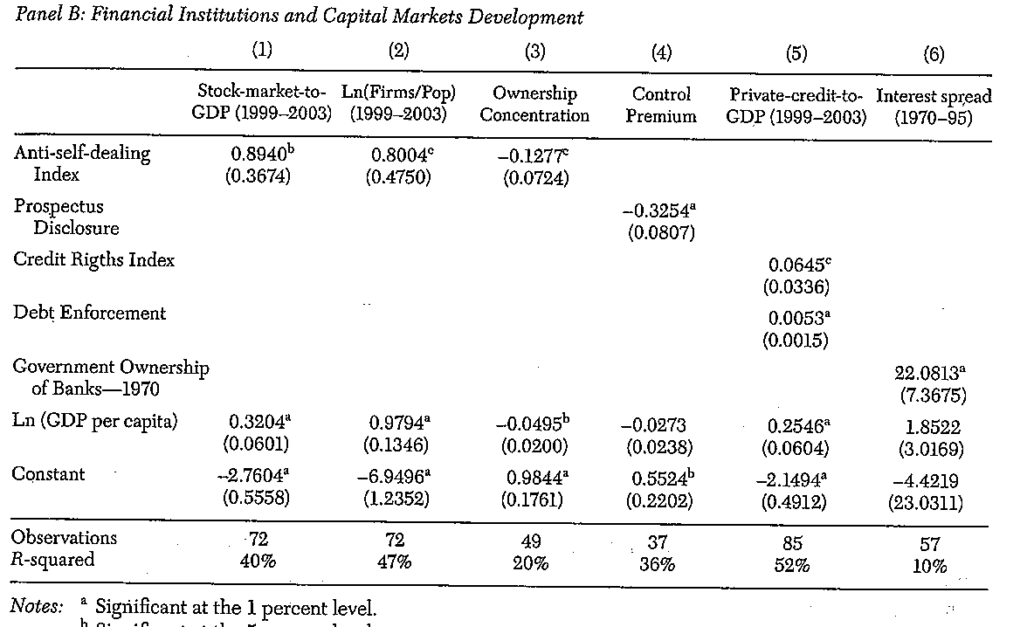

Slide 26
They also consider hypotheses of critics
That cultural or political factors are more fundamental than legal origin

Slide 27
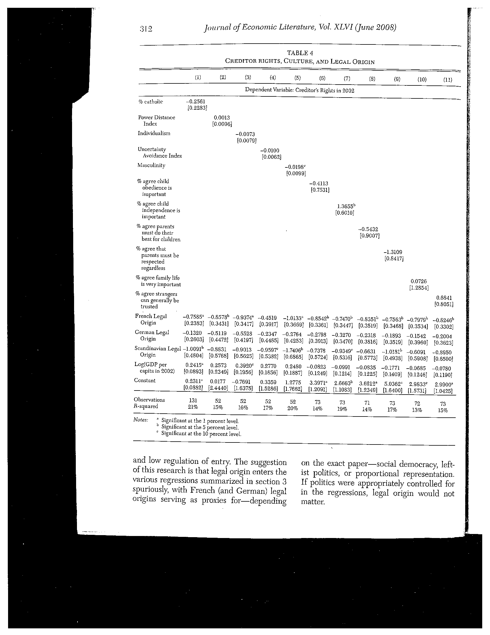

Slide 28
